Slide 1
Family Court Training
October 12, 2018
Dorinda Silver Williams, PhD, LICSW
Georgetown University, Center for Child and Human Development
dw831@Georgetown.edu

Slide 2

The impact of domestic violence on babies and toddlers
Promoting resilience in our most vulnerable family members
This Photo by Unknown Author is licensed under CC BY-SA

Slide 3


Why the stakes are so high
Photo credit: Shutterstock
  Extraordinary development
    Foundational
    Comprehensive
    Rapid

Slide 4
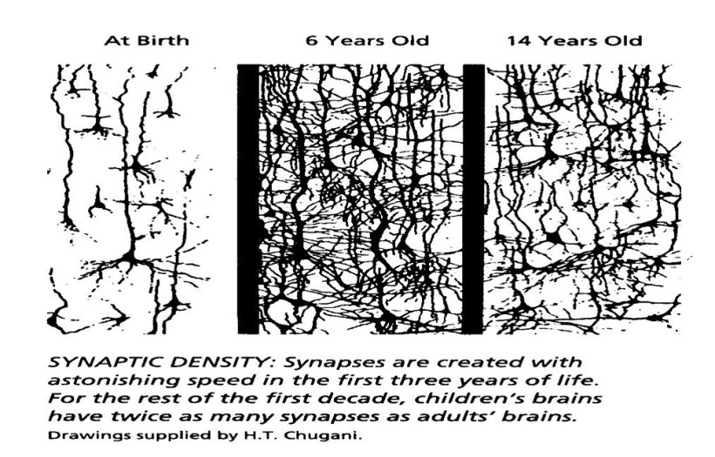
Brain connections and plasticity
Microsoft.com
Notes:
Neuroplasticity: The lifelong ability of the brain to reorganize neural pathways based on new experiences
The wiring of our brain; experience dependent; therefore the early years are both a period of tremendous opportunity and vulnerability depending on the kinds of experiences that a child has.

Slide 5
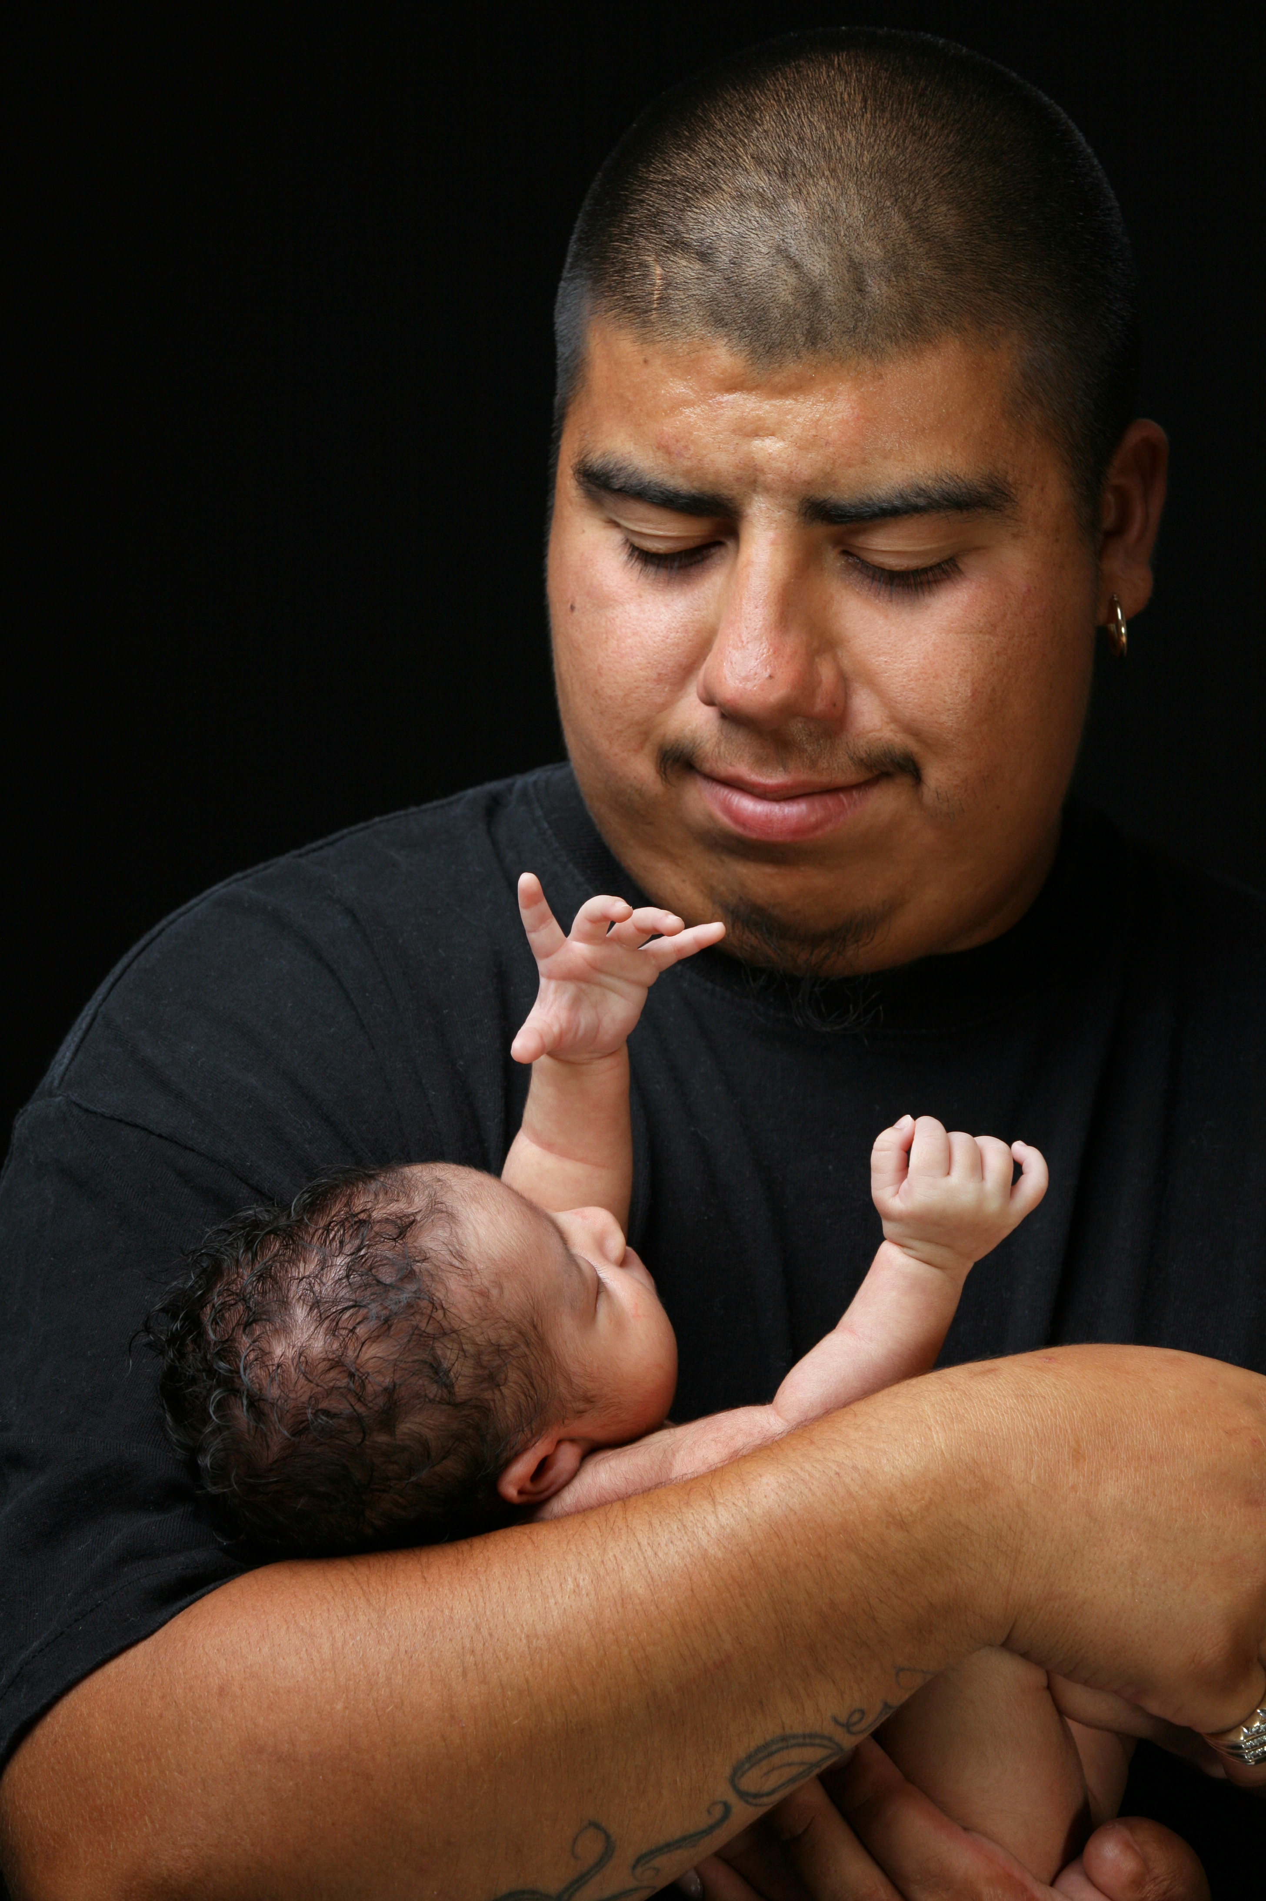
The power of relationships
Photo credit: Shutterstock
Notes:
Our earliest relationships inform how we will relate – to our environment, to others, to ourselves – for the rest our lives.
Relational template; what Bowlby referred to as an internal working model; our lens for experiencing ourselves, others, and the world around us
Helps us with our regulatory capacity; our physiological system is not fully online when we’re born…we have to borrow our capacity to regulate our emotions and strong feelings from our caregivers until, over time, we’re able to internalize it ourselves
http://www.bing.com/videos/search?q=still+face&view=detail&mid=6E971D60A22761B62BFF6E971D60A22761B62BFF&FORM=VIRE3

Slide 6
Early development across multiple domains
Cognitive development
Physical development
Social emotional development
Language development

Slide 7

Secure attachment
Developing a healthy relational template
Ainsworth, 1978; Bowlby, 1988
Photo credit: Shutterstock
Notes:
Holy grail of attachment; expectations for the relationship;
Contingent on parent’s physical and emotional availability
“I can count on you. I feel good about going out to explore my world – I always have you to come back to when I need a little reassurance.”

Slide 8

Our to-do list for parents
Be emotionally present
Be sensitive and attuned
Respond contingently
Foster routines and predictability
Co-regulate
Experience joyful interactions
Photo credit: Shutterstock

Slide 9

What parents/caregivers might be, or have been, experiencing
Social injustice
Poverty
Domestic violence
Community violence
Mental health challenges
Developmental and/or complex trauma
Limited social support
Photo credit: Shutterstock
Notes:
financial insecurity
food insecurity
job insecurity
Housing insecurity
Social determinants of health; health disparities
Depression and/or trauma
Institutional racism
Immigration stress/trauma
Health disparities

Slide 10
Early childhood stress
Positive stress
Tolerable stress
Toxic stress
National Scientific Council on the Developing Child, 2005/2014

Slide 11

Over time…
Neural circuitry may become wired for stress
Stress response system may become trained to work more for less
Relational template may be affected
Learning and development may be affected
Long term mental and physical health may be affected
National Scientific Council on the Developing Child, 2010; Thompson, 2014
Ainsworth, 1978; Bowlby, 1988
Felitti et al., 1998
Notes:
hypothalamic-pituitary-adrenocortical (HPA) system
Amygdala appraises potential threat/danger and sounds the alarm
Hippocampus helps to make note of the threat and files away for future use in assessing potential threatsAmygdala and hippocampus play key roles in activating release of stress hormones, including cortisol, which helps the body prepare for danger.

Slide 12
What can we do to help?
Family/Relational
Systemic
    Ideally, supporting key
    relationships in the face of
    removal and reunification
    Building relationships across
    roles, disciplines, and settings
    Taking care of those who are
    taking care of families
    Promoting protective factors
    Promoting social justice
    Integrating programs/
    interventions that
    support the child, the
    caregiver, and the
    relationship
    Fostering a culture
    of trauma-informed,
    Strengths-based, collaborative
    care

Slide 13

Thank you for all that you do on behalf of children and families
Photo credit: Shutterstock

Slide 14
Resources for promoting connections
The California Evidence-Based Clearinghouse for Child Welfare (CEBC)
  http://www.cebc4cw.org/topic/infant-and-toddler-mental-health-0-3/
SAMHSA’s Trauma-Informed Approach: Key Assumptions and Principles
  https://store.samhsa.gov/shin/content/SMA14-4884/SMA14-4884.pdf
Protective Factors Framework
  https://www.cssp.org/young-children-their-families/strengtheningfamilies/about/protective-factors-framework
ZERO TO THREE’s Safe Babies Court Team™ Approach
  https://www.zerotothree.org/resources/1655-the-core-components-of-the-safe-babies-court-team-approach

Slide 15
References
Ainsworth, M. D., Blehar, M. C., Waters, E., & Wall, S. (1978). Patterns of attachment: Assessed in the strange situation and at home. Hillsdale, N.J.: Lawrence Erlbaum.
Bowlby, J. (1988). A secure base: Parent-child attachment and healthy human development. Basic Books.
Felitti, V. J., Anda, R. F., Nordenberg, D, Williamson, D.F., Spitz, A. M., Edwards, V…Marks, J. S. (1998). The relationship of adult health status to childhood abuse and household dysfunction. American Journal of Preventive Medicine, 14, 245 – 258.
National Scientific Council on the Developing Child (2010). Persistent Fear and Anxiety Can Affect Young Children’s Learning and Development: Working Paper No. 9.
Retrieved from http://www.developingchild.net
National Scientific Council on the Developing Child (2005/2014). Excessive Stress Disrupts the Architecture of the Developing Brain: Working Paper No. 3. Updated Edition. Retrieved from www.developingchild.Harvard.edu.

